Slide 1
COP290 Task-2
Team :
Earavelly Sriharshitha-2020CS10345
Nimmala Abhilokesh-2020CS10364

Slide 2
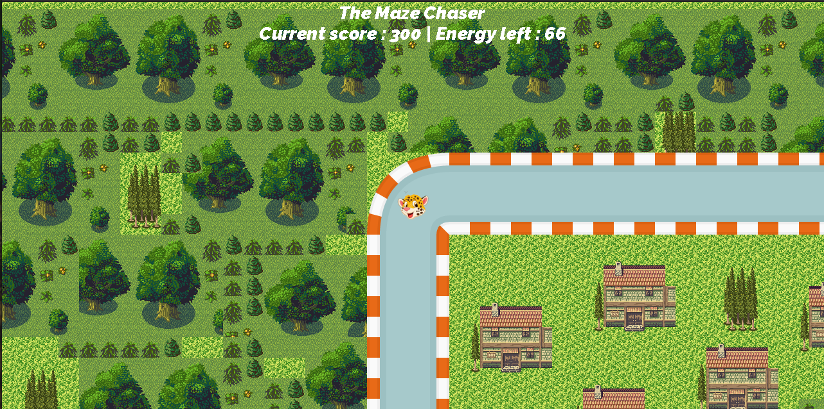
The Maze Chaser

Slide 3
IIT Delhi Maze

Slide 4

Single Player Mode
We are going to play on an IIT Delhi maze and our player( )starts from the Main gate and have to reach SAC.
Initially we are given with an energy and kiddy bank balance of 300 each.
The game will over if any of the balance or energy becomes <0.

Slide 5
Game Rules
We use , , , keys for movement of the player.
• When the game starts the energy will start draining.
• We have placed ATMs and Energy stations in the maze.
• We have to brought energy from food points using kiddy bank which will deduct 150 for increasing energy by 100.

Slide 6
Game Rules
We can increase our kiddy bank balance by using ATMs. Our balance will increase by 100 by going once across the ATM.
• The player will win when he/she reached SAC before the energy/kiddy bank becomes negative
• Otherwise the player will reach the stage of “GAME OVER”.

Slide 7
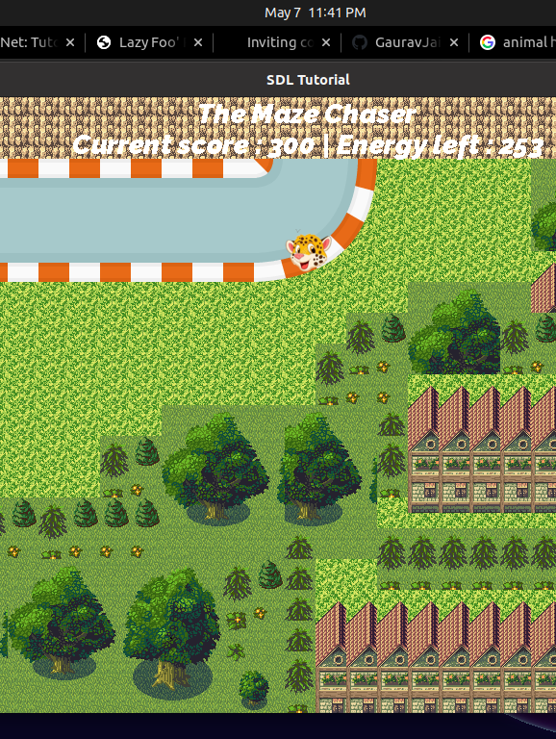
Game Visuals
Game Starting

Slide 8
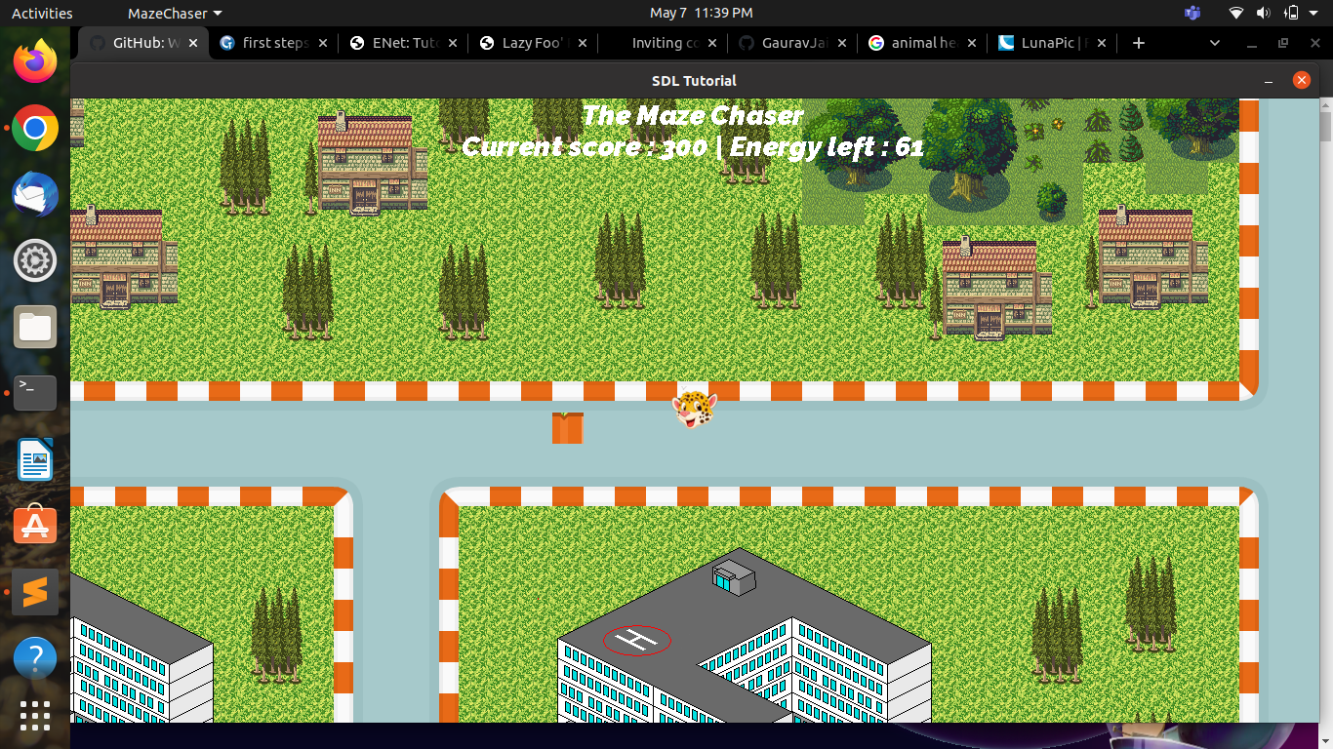
Red blocks in the road are Food points

Slide 9
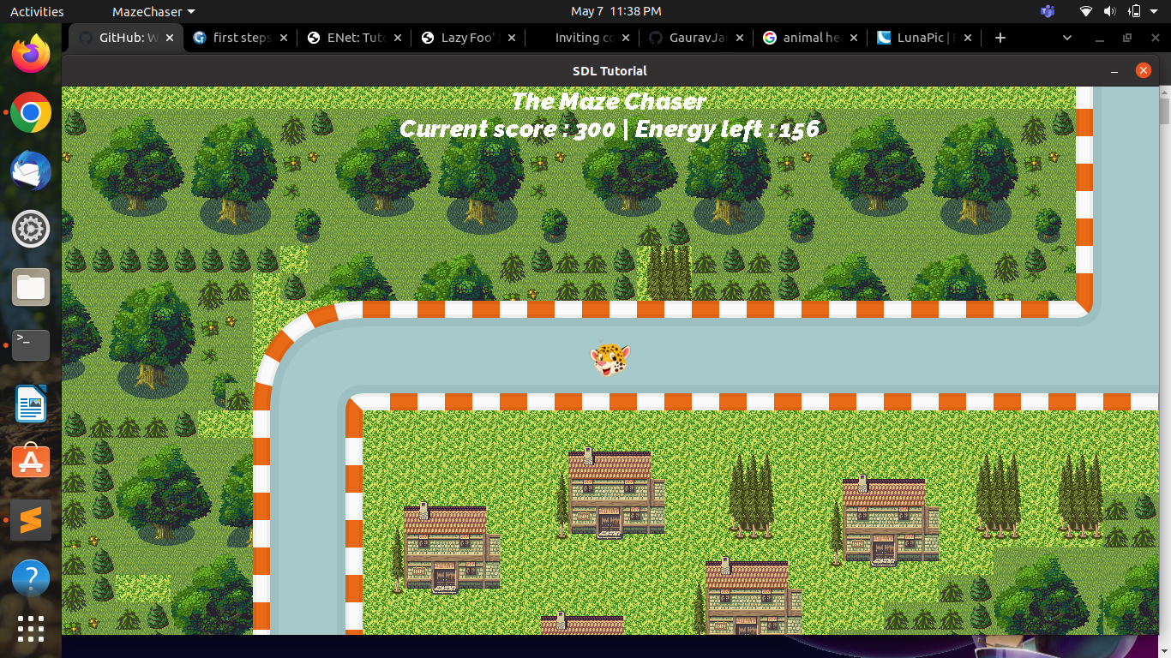
In between the game

Slide 10
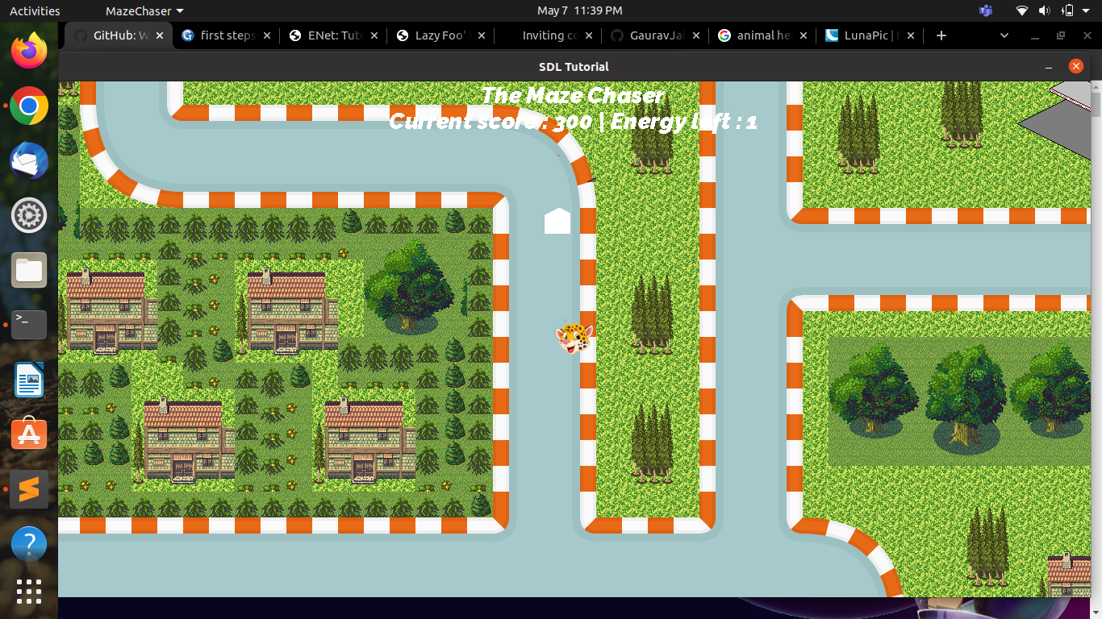
White blocks in the road are ATMs

Slide 11
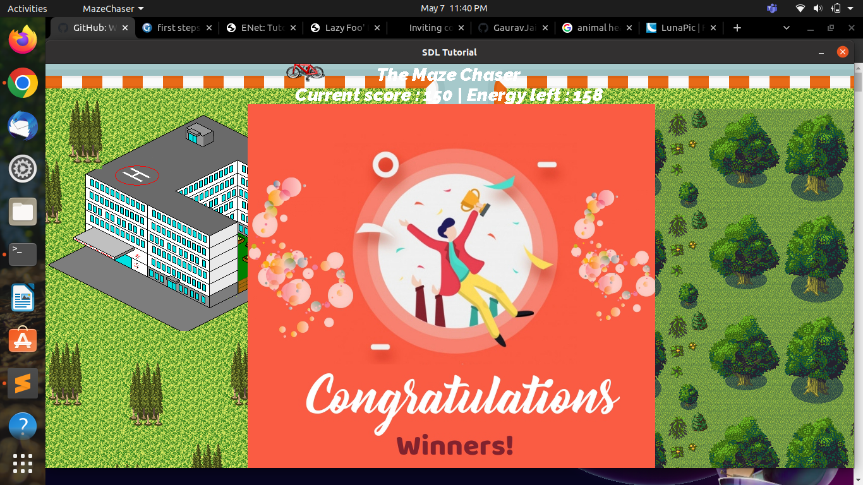
Player wins

Slide 12
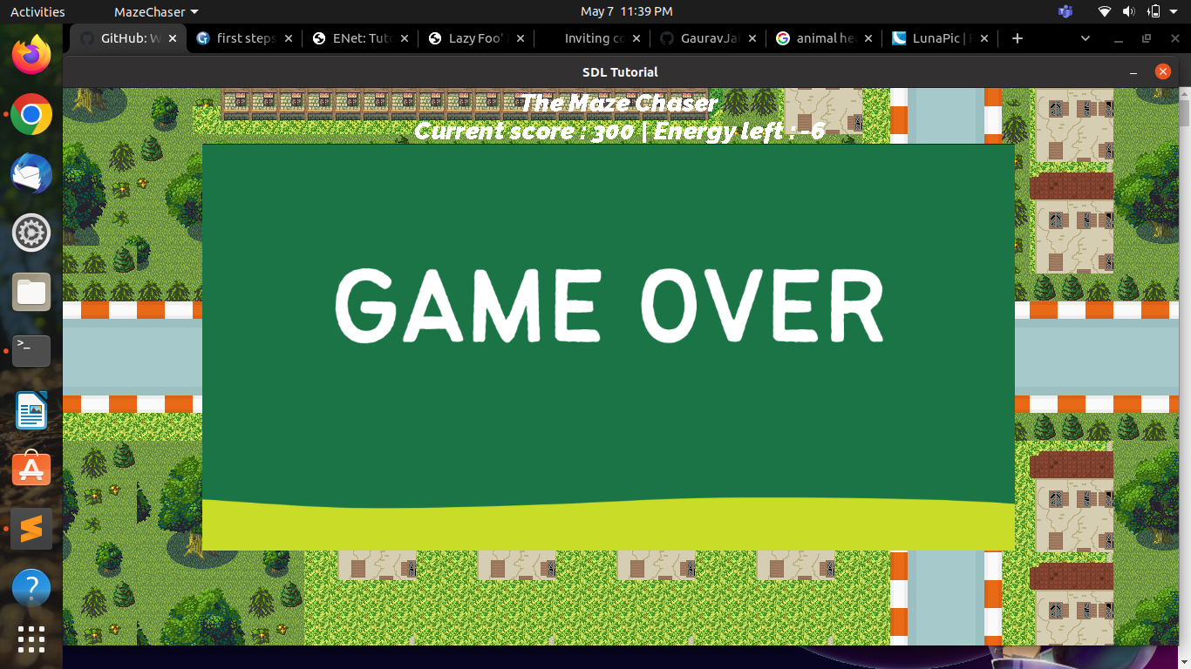
Player Lose

Slide 13
References
https://lazyfoo.net/tutorials/SDL/index.php
https://github.com/schuay/pacman
https://github.com/DarkMuffinJoe/Pacman
https://en.wikipedia.org/wiki/User:Dllu/Maze

Slide 14
ThankYou

